Slide 1
An introduction to apprenticeships
For Parents and Carers
Notes:
My name is ‘insert name’ and I’m here on behalf of the Education and Skills Funding Agency, which is a part of the Department for Education, to talk to you today about apprenticeships.
As parents and carers, we know that you are keen to hear about all options available to your child so that you can support them in their decision making.
What we’re going to cover today is really important because even if your child does already know what they’re planning to do after school – plans can change and so it is important that they are aware of all of the options available to them so that they can make the most informed decision for them.
Apprenticeships have also changed significantly over the past few years and there are some brilliant opportunities available for your child. Through apprenticeships, you could even now achieve a degree if you wanted to, but I’ll tell you more about that in a few minutes.
So, for the next 20 minutes, I’m going to explain more about:
The range of apprenticeship job roles available
The different levels
How you find an apprenticeship
What your child would need to do next to start searching and applying

Slide 2
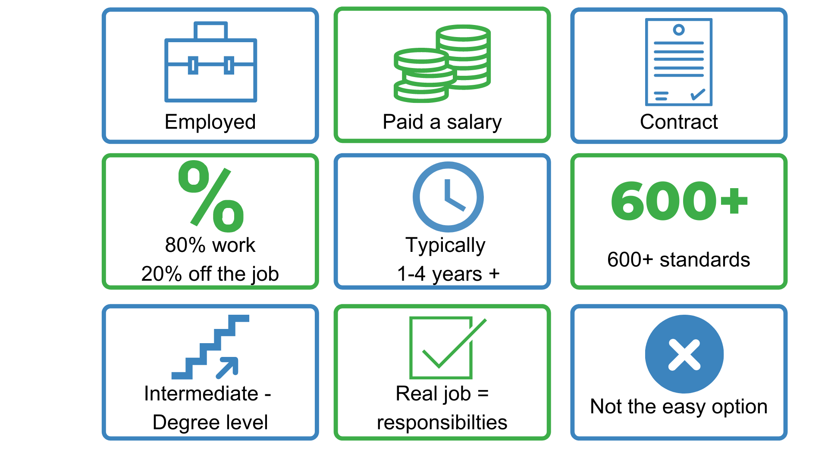
What are apprenticeships?
Notes:
So what is an apprenticeship?
An apprenticeship is a real job, with a real employer, where the apprentice will work full-time whilst also studying towards a qualification.
So you could be an apprentice working for Sky as a journalist, for example, whilst also studying and gaining a qualification in journalism.
PAID A SALARY
As it’s a real job, you will earn a wage – and it can be a really good salary too! The salary of an apprentice can vary from employer to employer. Legally, an employer must pay an apprentice the National Minimum Wage for apprentices, which is currently £4.30 per hour. This is lower than the normal National Minimum Wage, but it recognises that some people will be going into their first job with little or no experience.
The good news is that lots of employers pay a lot more than the National Minimum Wage for apprentices, with some local employers offering starting salaries of £xx,xxx and other national employers even offering starting salaries over £15,000-£20,000.
I have pulled together some local vacancy information which I will show you in a little while, so you can see some real examples of local and national apprenticeships available and see what types of salaries are being offered.
It’s important to remember that if your child comes across an apprenticeship they’re interested in, to not be put off by the pay if it’s initially low: there’s room for progression and working your way to the top of an organisation and lots of employers will increase this as they achieve milestones during their apprenticeship.
CONTRACT
You will also get a contract of employment, holiday pay, annual leave etc – exactly the same as any other member of staff.
80% WORK 20% OFF-THE-JOB
The apprentice will spend 80% of their time ‘on-the-job’ (doing their role), and 20% of their time ‘off-the-job’, studying or working towards their qualification.
This study element (off-the-job) would take place with a training provider, who will help them to achieve the qualifications and make sure they complete their apprenticeship.
Training providers could be colleges, Universities or independent training provider organisations, who deliver the training/teaching element of the course.
The employer will also support the apprentice, helping an apprentice to gain qualifications and valuable new skills and experience. As well as their time, employers also pay the fees of the apprentice’s training, showing their investment in the apprentices development.
TYPICALLY 1 – 6 YEARS
An apprenticeship typically takes 1 to 4 years to complete (sometimes up to 6 for some areas like a Solicitor). As a minimum, all apprenticeships must last for a minimum of 12 months.
The total duration will depend on the delivery model that the employer selects (how the mixture of training and working is delivered), the level (which we will come onto explain) and the subject they are studying.
600+ STANDARDS and INTERMEDIATE – DEGREE LEVEL
There are more than 600 different apprenticeship standards covering many different levels of apprenticeships, from Level 2 (which is the equivalent of 5 GCSEs), all the way up to Level 7, which is masters level. So you can actually work your way towards gaining a degree or masters through an apprenticeship. We will discuss this more shortly.
REAL JOB = RESPONSIBILITIES and NOT THE EASY OPTION
As I said before, it’s a real job and so it’s important to remember that apprenticeships aren’t the ‘easy option’. Holding down a full time job and studying takes a certain skill and commitment, and it won’t be right for everyone.

Slide 3
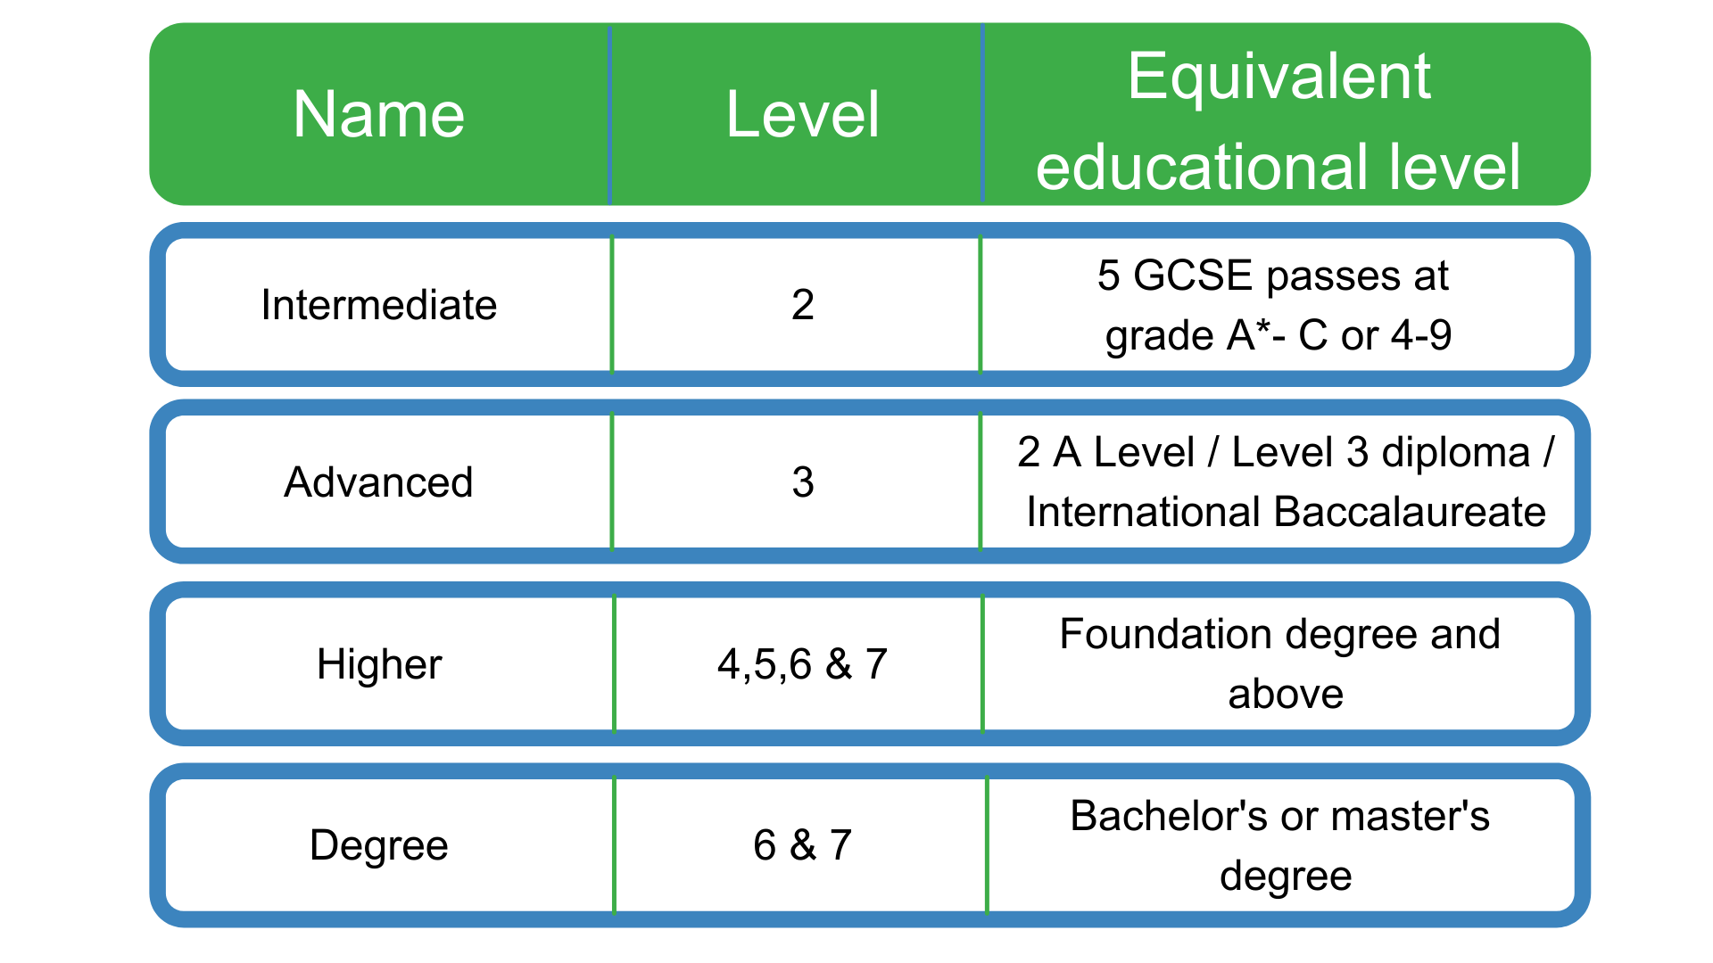
Apprenticeship levels
Notes:
Each apprenticeship has a level which will falls into one of the four categories above: Intermediate apprenticeships, Advanced apprenticeships, Higher apprenticeships and degree apprenticeships.
The equivalent educational level column helps to explain what level the qualification at the end of the apprenticeship will be in comparison to more familiar qualifications, like GCSEs and A Levels.
So you can see that if you do a Level 3 (advanced) apprenticeship, once you have qualified you’ll have gained a qualification that is equivalent to 2 A Levels, a Level 3 diploma or other equivalents, like IB’s or BTECs.
The level of apprenticeship you start at will depend on the kind of job that you are applying for.
It’s really important not to be held back by only looking for a particular level e.g. degree apprenticeships. Following the way that schools/colleges work, it is understandable that lots of students think that they should progress straight onto the next level, so if they leave after GCSEs they should do a Level 3 and if they finish after A Levels they should go for a degree apprenticeship, but this isn’t always the case.
Depending on the sector and apprenticeship, it may be that they need to start at advanced or higher level and work their way up, or that brilliant apprenticeships are only offered at Level 2 or 3 – for example, Journalism is only offered at Level 3 because that is all the industry requires.
Equally, your child may be entering a completely new sector or industry that they haven’t studied or worked in before, and so may need to do a Level 2 or 3 to enter the world of work, get their foot in the door with the employer and get that basic entry understanding of the role, the requirements, the employer and the sector first. They can then progress their way up the levels with more foundation knowledge and expertise and feel really confident completing a higher level qualification whilst working.
It is therefore very important for them to keep an open mind so that they can explore all of the opportunities available and have multiple options available when applying.
We have also come across some young people before who have only applied for one or two Higher and Degree apprenticeships after their A Levels, but unfortunately have not achieved the entry requirements for that role and so cannot do the apprenticeship.
We therefore encourage all students to apply for not only lots of options, so University, apprenticeships, gap years etc, but also lots of types and levels of apprenticeships, so that when they come to making that decision in August when they get their results, they have lots of options.

Slide 4
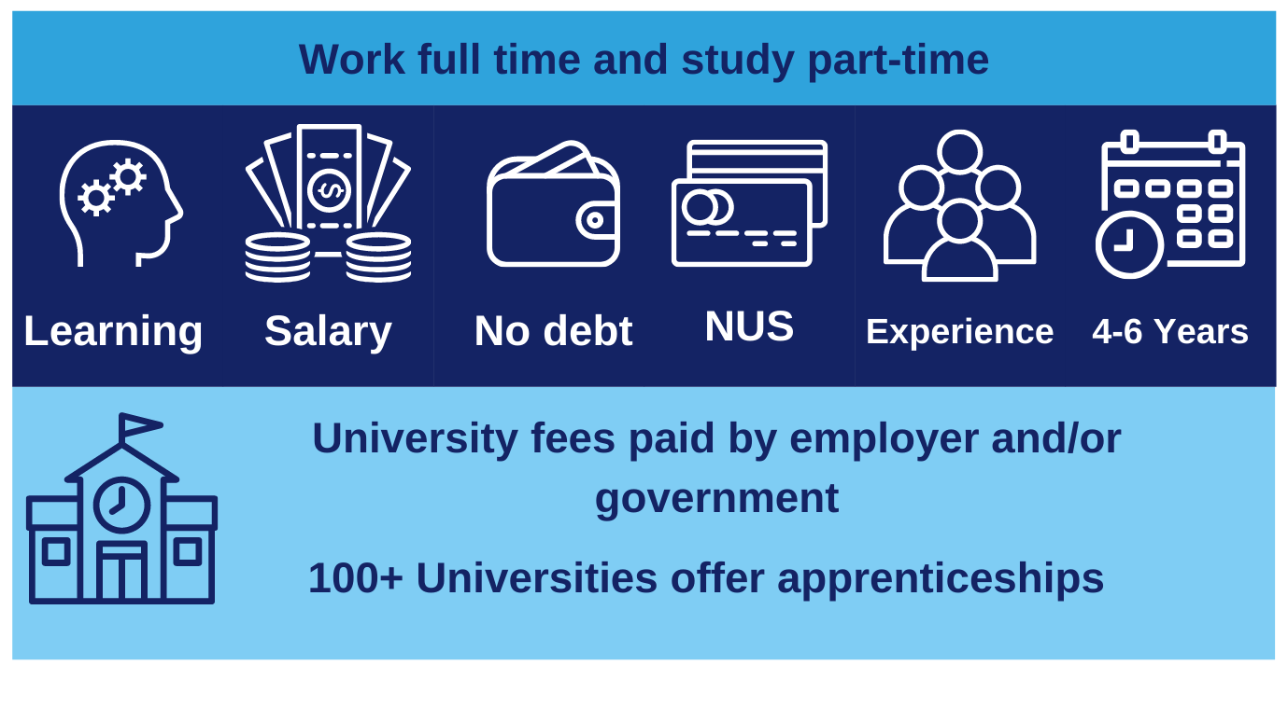
Higher and degree apprenticeships
Notes:
Presenter notes: Is this slide appropriate for your audience today?
Higher and degree apprenticeships are a real alternative to following the traditional route of going to University as a full-time student.
These are becoming more and more popular because they offer all the benefits of higher education with none of the cost.
Degree apprentices will not only be learning, but earning a salary, from day one. Your tuition fees are paid for by your employer and the Government, so you will not be expected to pay £9000 a year and are much less likely to build up any debt.
More than 100 Universities in England offer degree apprenticeships now.
The students on degree apprenticeships are entitled to exactly the same as other students, so they will still have access to the student union, sports facilities, clubs, societies and student discounts, as and when this is appropriate.
In the past, going to university was seen as the best way to advance your career to a higher level. But with the current level of competition for jobs amongst graduates, it might not be the best route for your child. With an apprenticeship, they gain the competitive advantage of gaining at least 3 years’ work experience whilst completing their degree, and so have the experience as well as the qualification.
However, it is hard work as a degree apprentice. You’ll be working full time and fitting in the equivalent of a full time degree alongside it, so it is not the easy option and does require a certain skill and dedication to manage and balance the workload.
Because of the combination of study and working, it might take a bit longer than studying full time – for example, 4 years instead of 3, but you’ll achieve exactly the same degree.
No matter what kind of career your child wants to follow, they need to do their research and find out if there’s a way to get to the role they want through an apprenticeship. That way, they can decide if they would prefer to study full time at college or university, or if you would prefer to go into work as an apprentice and gain qualifications and experience on the job from day 1.
As I said before, they can apply for apprenticeships alongside applying for university and then decide what is right for them later on.

Slide 5
The truth about apprenticeships
Notes:
Presenter notes: Please add in any other queries you may be picking up from other sessions and answer those questions here.
There are lots of myths about apprenticeships, because they have changed so much in the past few years, and therefore different concerns for you as parents and carers may come to mind for apprenticeships.
So I wanted to discuss some of these with you today.
Suggested interactivity: This is a good opportunity to open up the discussion to Q&A with parents and ask them to share their questions about apprenticeships and some of the different myths they may have heard that they’re unsure about.
LACK OF VACANCIES AFTER THE PANDEMIC
One of the biggest concerns we are hearing from parents in more recent times is that there aren’t any jobs/vacancies available after the pandemic.
It is true that the number of apprenticeship vacancies did drop during the pandemic, as did many other entry level schemes, such as graduate recruitment and a recruitment as a whole, whilst employers paused recruitment to focus on supporting existing staff and business needs at the time. However, we have already been seeing a significant increase in vacancies from the beginning of the school year as employers have started to open up their schemes again and take on new staff.
So this is really positive and particularly in certain growth sectors, we expect this to continue climbing.
There is also a significant amount of investment from the government in different technical programmes such as apprenticeships and traineeships to help people back into work.
NO PROGRESSION
One of the concerns we often hear from parents about apprenticeships is around the progression opportunities and whether it’s true that the employer will let the apprentice go once they have completed their apprenticeship. This is not the case, in fact the majority of apprentices (around 90%) stay in employment. If they do change companies, it’s usually because they’re able to compete for a better job, perhaps with more pay or more responsibility.
It also isn’t true that apprentices can only get to a certain level within an organisation, as their qualification is valued less than a degree for example. We come across employer after employer where they tell us that their Director started off their career as an apprentice, or that their apprentices are now managing their graduate peers because they have the in-work experience and so can guide the graduate cohorts on the ways of working.
So there really is no limit for apprentices, with their combined experience and knowledge, they are highly valuable employees that the employer has invested in (both financially and with their time) in training and upskilling them, so they do want to keep those individuals.
NOT A REAL JOB
Another common myth is that apprenticeships are not real jobs and that the apprentice is just used to make the tea and do the menial tasks. This is certainly not the case – we will shortly be discussing the different roles available through apprenticeships, from solicitors, to aerospace engineers, to cyber security analysts to midwifes – and all of these apprentices are working from day 1 of the apprenticeship, learning on the job how to fulfil that role and building their skills and knowledge. Apprentices are contributing to incredible projects and work all over the country, not just making the tea.
Presenter notes: Suggested to use a personal example here where you know an apprentice or YAAN and what their job role is.
NO SUPPORT
Another concern that we sometimes hear from parents is that they’re worried there isn’t as much support available for their child through an apprenticeship that they might get at college or University, for example, where they might have a dedicated tutor or additional support staff helping them, for example. The positive thing about apprenticeships is the network of people around apprentices trying to help them to succeed.
From their line managers, mentors or colleagues at work who will be training them and supporting them in their role, to the tutors and staff at the training provider, there should be lots of support available for the young person. Many employers and providers also offer lots of other supportive initiatives and networks, such as apprentice networks, community networks or mental health and wellbeing support, for example.
SOCIAL LIFE/NETWORKS
Another concern for some young people that we hear is that they are worried that as an apprentice, they won’t get to have fun or meet other young people.
Depending on the size of the company, they may find themselves working with lots of other young people, or they may meet them through their apprenticeship training. Lots of employers and training providers try to offer ways for apprentices to connect with each other, through social events, team activities, networks and other support.
Some bigger employers, for example, have helped their apprentices who are re-locating for work to link up with other apprentices who are re-locating and find shared accommodation.
They can also join a number of different apprentice networks, including the Young Apprentice Ambassadors programme, where they will meet and connect with hundreds of other apprentices.
RELOCATION
Linked to this, one of the best things about apprenticeships is that they are everywhere. So if your child wants to carry on living at home then they can, but they can sometimes move around the country with an apprenticeship. It’s really important they do their research – but some companies will help them to relocate to work for them.
Suggested interactivity: Open this up for Q&A with parents to dive deeper into the discussions:
Are there any other concerns you have as a parent that you’d like to share?
From what we’ve discussed already, is there anything you’d like to discuss in more detail?

Slide 6
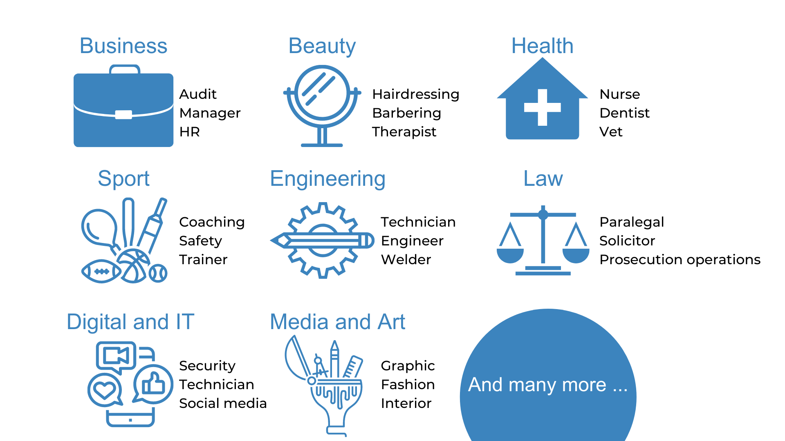
The range of apprenticeships
Notes:
Presenter notes: Please add in some local opportunities to the slide above (a mixture of traditional and non-traditional job titles) to also bring the range of the local offer and facilitate discussions below.
We’re now going to take a look at the different job roles available through an apprenticeship and when we talk about apprenticeships, people often start to think of Plumbing, Electrical and some of the other construction trades. There are many brilliant apprenticeships in these areas, but there are also hundreds of new apprenticeships in exciting areas that you might not know exist.
Suggested interactivity: Ask the audience ‘does anyone know of any apprenticeships that they might expect to see on this list?’
Once completed, click on for the image.
The range of apprenticeship job roles out there is amazing.
This slide gives you an idea of the huge range of apprenticeships available and this is just a taster – there are now over 600+ different apprenticeship standards available, resulting in over 1,500+ different job roles.
You could start an apprenticeship in hundreds of occupational areas. Some will amaze you!
Suggested interactivity: Depending on the time available…
Activity idea: Pick out a few of the job roles to discuss – will depend on the audience.
Activity idea: Can anyone spot an apprenticeship on the screen that has surprised them?
Activity idea: Does anyone know someone who is doing an interesting apprenticeship?

Slide 7
Which employers offer apprenticeships?
Notes:
Presenter notes: Please update this slide with local companies if you feel that the logos are not representative of your area. Please include small and large organisations.
Equally, the range of employers offering apprenticeships is incredible.
This slide shows you some really familiar logos of big companies in England who all recruit apprentices.
Some of these employers may not be recruiting currently, but you will be able to track their recruitment updates on their websites or social media.
Around 50% of apprenticeships started are with large companies like this, but 50% will be with smaller local companies.
It can be tempting to think that the ‘best’ apprenticeships are just with the big, well-known companies, but many of the smaller employers have absolutely brilliant schemes that enable fast-track career progression for their apprentices, so it’s really important to do your research and not to ignore smaller employers because they can be just as good.
Presenter notes: Please include an example of a local company in the town that you are delivering in. An example of a small local company is…X who employs apprentices in job roles like X and X etc.

Slide 8
Look inside the company
Logistics
IT and Cyber Security
Data Analytics
Sales
Business Development
Marketing
Human Resources (HR)
Finance
Legal
Facilities Management
Security
Customer Service
Training and Development
Notes:
They will also need to think about the different roles that a company might have.
For example, if they want to work in finance – they shouldn’t just look at the big finance and accountancy companies. Lots of other companies will have their own in-house finance departments where they would still have access to a huge range of experiences and opportunities.
It can be a good idea to take some time to look at the different departments that a company has and see if they offer an apprenticeship in that area.
For example, your child could work as a solicitor for Coca-Cola, a website designer for Vauxhall, as a Cyber Security apprentice for the Government. There are thousands of different opportunities!
Presenter notes: Please update the example if you feel that mentioning Vauxhall or Coca-Cola are not representative of your area.

Slide 9
Vacancies near me – are there any?
Vacancies
In your area:
5 miles = 90 vacancies
10 miles = 293 vacancies
15 miles = 820 vacancies
20 miles = 1507 vacancies
Notes:
Presenter notes: We would expect this slide to be updated by the delivery partner to reflect local opportunities by searching through Find an Apprenticeship
So as I said before, I had a look on the Find an apprenticeship website before coming along today so that I could see how many vacancies are out there at the moment.
If you notice, within 5 miles of this school/college today, there are xx vacancies.
You can see how this number grows the more you increase the distance.
Your child will need to think about how far they are prepared to travel for work each day and how realistic this might be for them in terms of public transport access or support in getting there if it is a bit further.
As I said, it is important not to restrict their searches for vacancies to just look at large companies as many small employers offer some excellent vacancies with great packages and career progression opportunities.
It is also important to do some wider research and look in lots of places for apprenticeships. Where vacancy numbers on Find an apprenticeship have decreased over the period of the pandemic, it will be important to look at employer websites and on other job sites also to find the best opportunities for them also.

Slide 10
Apprenticeship jobs in the local area
Job opportunity | Level | Closing date | Weekly salary | Annual salary
Customer Services, HSBC Bank | 3 | 17th April | £385 | £20,020
IT Engineer, Amazon | 4 | 31st March | £578 | £30,056
Project Manager, Virgin Media | 4 | 11th April | £384.62 | £20k
Engineering, Ford Motor Company | 6 | 30th June | £413.06 | £21,479
Accounts (ACA), MHA Macintyre Hudson | 7 | 31st March | Competitive | Competitive
Notes:
Presenter notes: Please update this slide with relevant examples for your audience
Search through Find an apprenticeship using the establishment postcode and find some interesting jobs.
Try to find a selection of closing dates so that you can reinforce the need to be using Find an apprenticeship regularly
Try to find a range of salaries so that you can show that there are employers who are prepared to pay more
Try to find a job title that might sound a bit confusing and then explain what that role really is – make it sound exciting and explain that they should not be put off by the titles of some jobs, it’s important they read the job advert attached to it.
Think about STEM vacancies. Can these be showcased more?
This slide shows a range of vacancies that I could find.
You will notice that they all have different closing dates – this is one big different to applying for university.
If you do see a closing date, it’s important that you don’t wait until the very end to submit your application. We are now finding from talking to employers, if they receive a huge number of applications, they may decide to close the application window early.
You will also notice the range of different salaries too – this is because employers can decide what to pay (as long as it meets the national minimum wage for apprentices of £4.30)
Presenter notes: It might be useful to have the find an apprenticeship website open to show them current examples and what the site looks like. This is also relevant for the next slide.

Slide 11
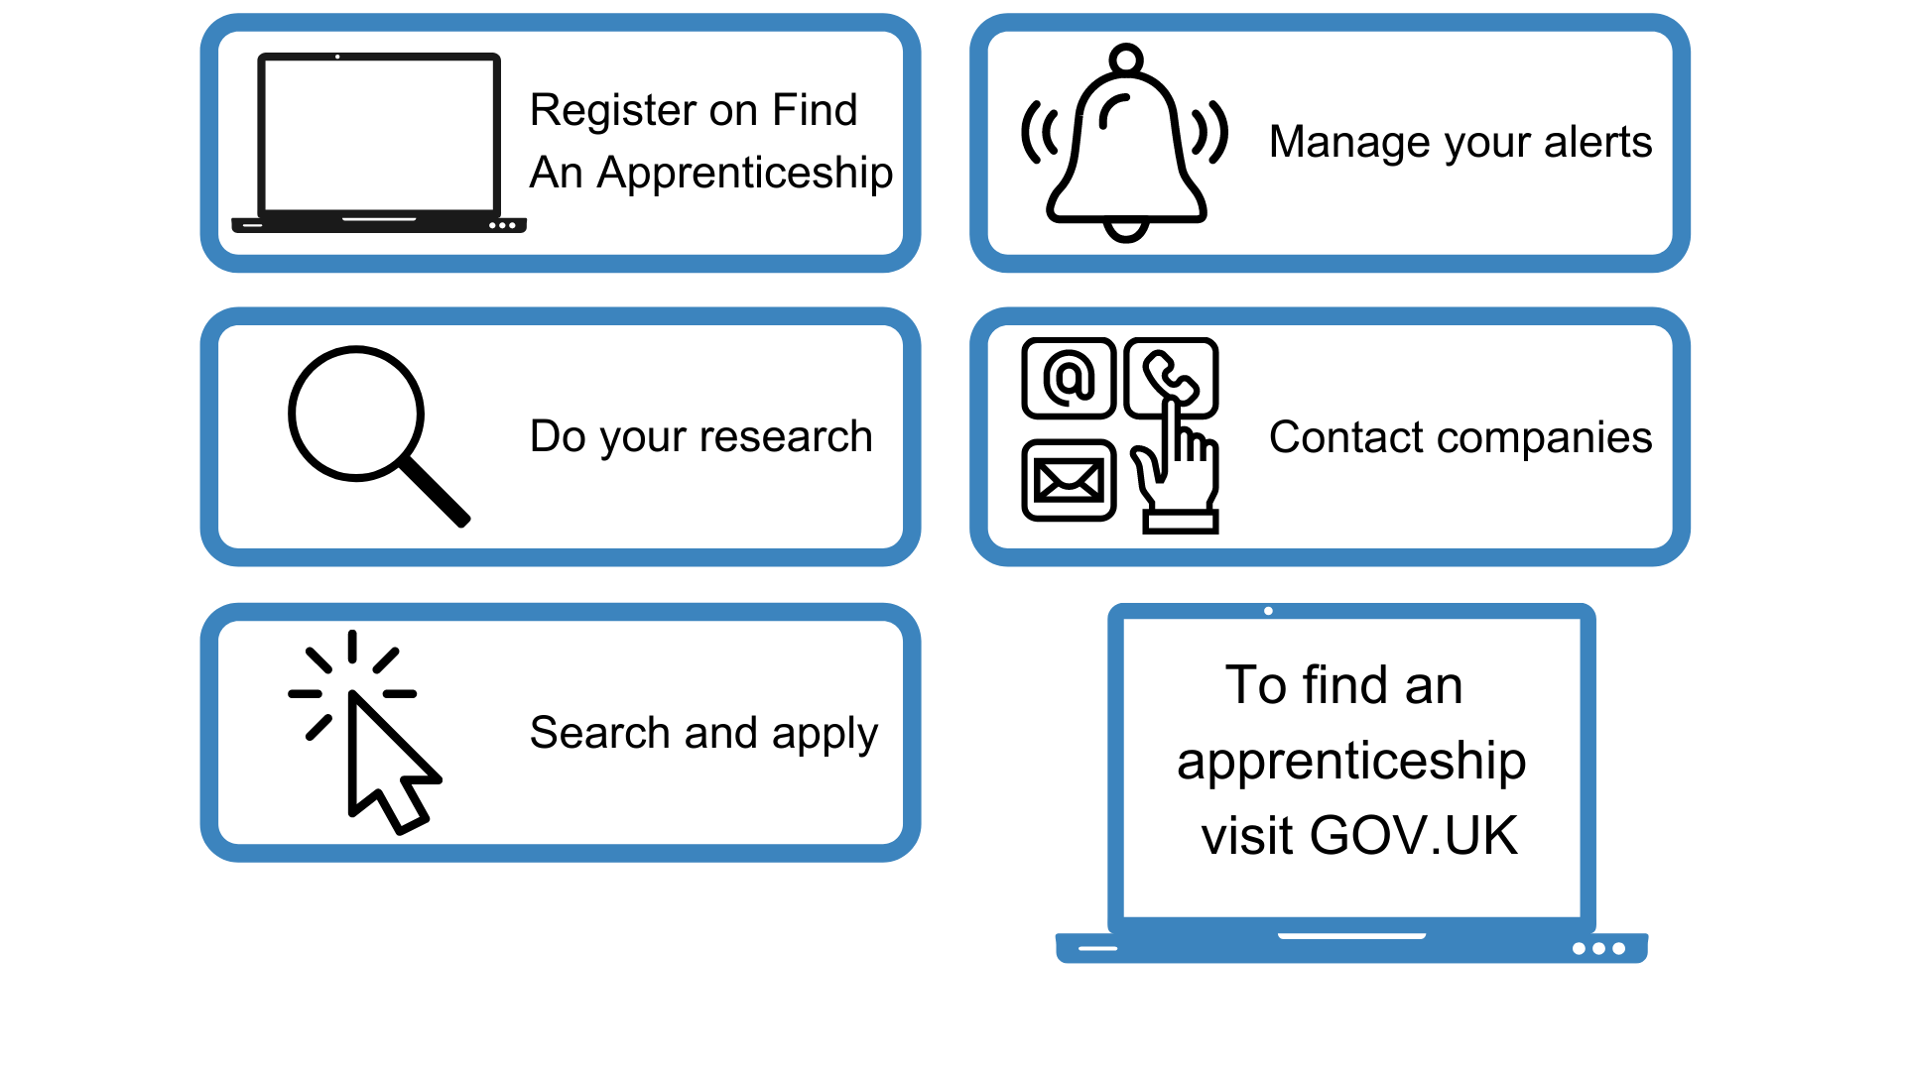
How do you find an apprenticeship?
Notes:
1. It’s really important your child registers on Find an Apprenticeship. They can search the internet for ‘Find an apprenticeship’ and it will come up as the first link The search page is on gov.uk, an official government site. Once your child registers, they’ll receive an account activation code by email. After activating their account, they’ll be ready to start applying for apprenticeship vacancies.
2. Have a look at the different jobs that are being advertised. Remember, this is a live jobs site so it may be that they need to try a few different searches or to broaden how far they are looking to find jobs that they are interested in.
As I noted earlier, the number of vacancies might currently be down but are on the increase. Whilst this is expected as the economy recovers, it can be quite disheartening for your child if they take a look and cannot find anything immediately or in the coming weeks. So it will be important to remind them that vacancies are being added on every day and so it’s important to keep coming back to the site and to use the alerts to be flagged to exciting opportunities. In the meantime, there also lots of other helpful sites they can be searching, including interesting employers.
3. Start applying for jobs that interest them. They need to remember that some of the bigger companies will advertise quite early in the year (e.g. Autumn) for apprentices to start the following September so they should not leave it until the last minute or they might be disappointed to have missed a great opportunity.
Recruitment timeframes may have changed over the last couple of years and so it will be important to stay on top of these.
4. Set up alerts. A great feature of this system is that you can get it to do all the hard work for you. You can manage your alert settings so that you receive text messages and emails when jobs come up that you might be interested in.
5. Employers are always telling us that the applicants that really stand out to them, are those that have made a bit of extra effort. Your child could consider contacting the company and asking them if they have any virtual open days coming up or other opportunities to engage with them. That will look really impressive on their application and can give them an advantage over other applicants

Slide 12
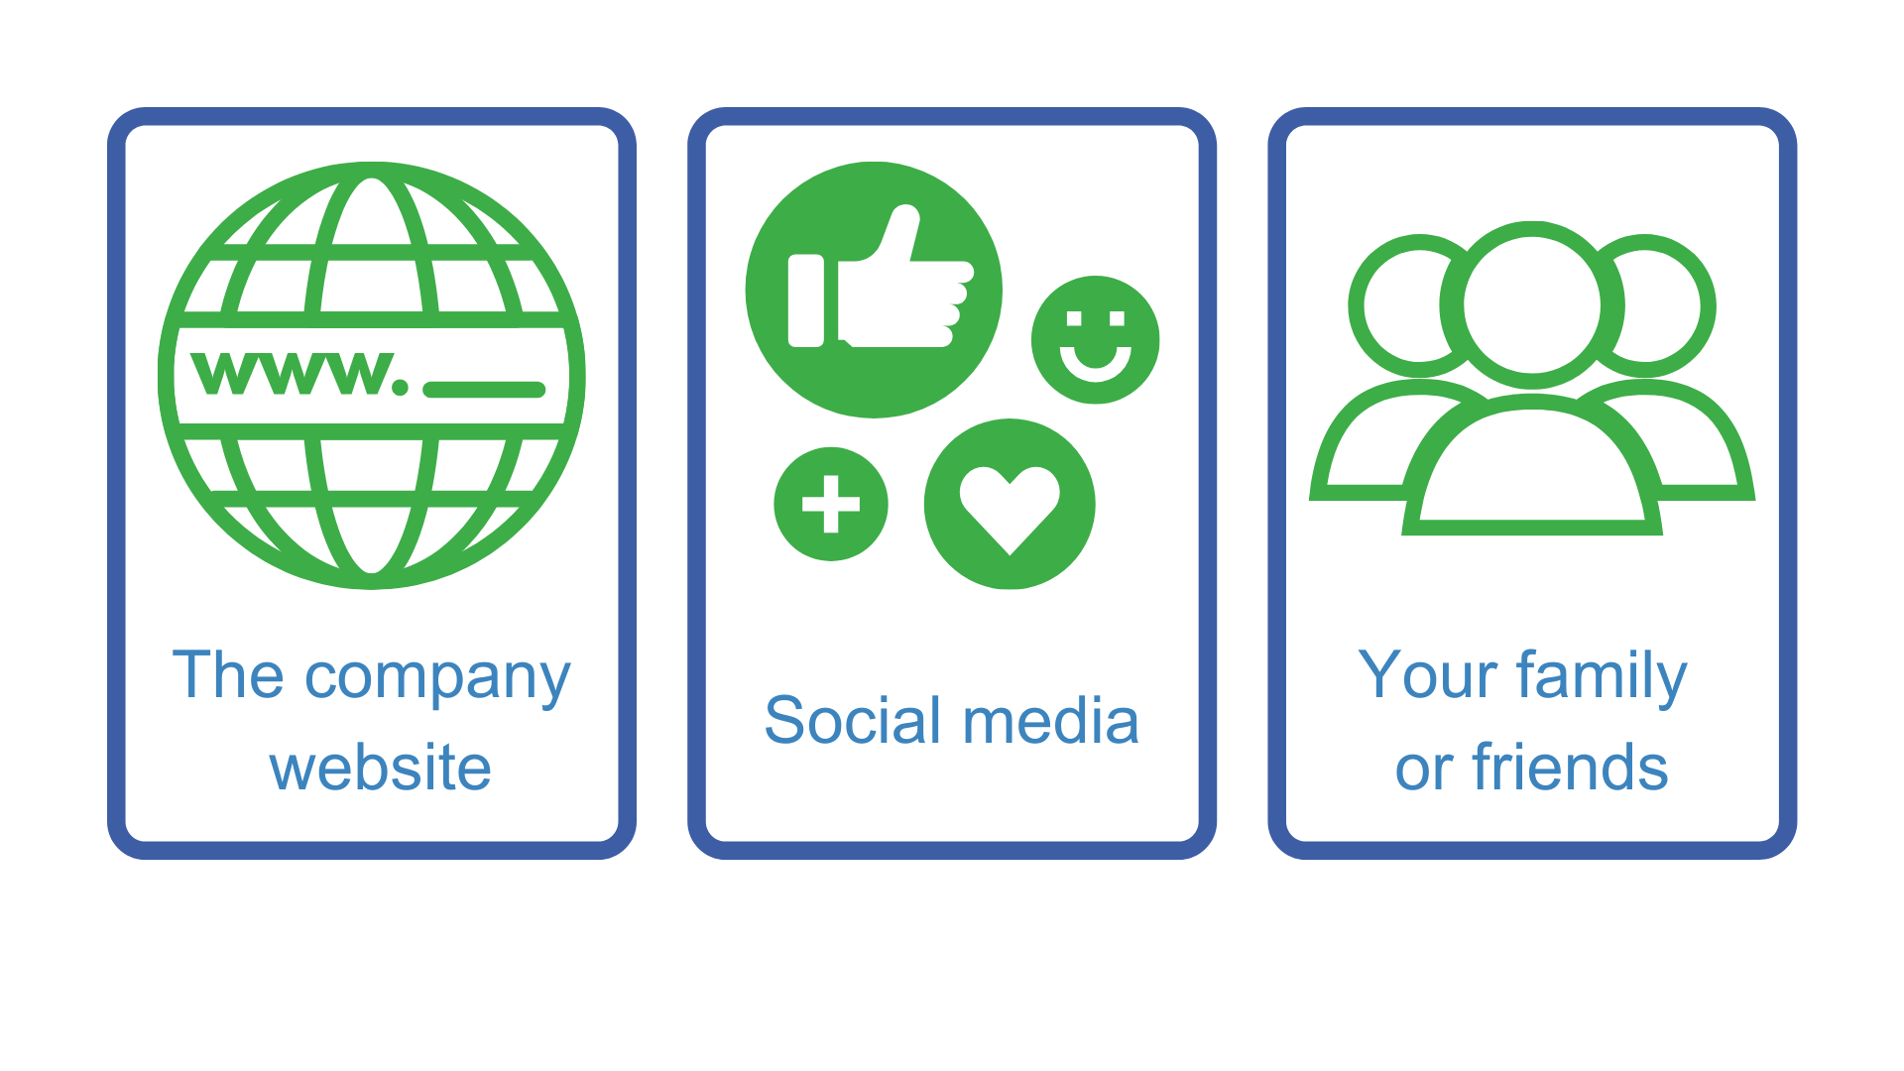
Other places to look
WHERE ELSE TO LOOK?
Notes:
Whilst Find an apprenticeship is a great place to start looking for apprenticeships, it is not the only place.
If your child has a particular employer in mind, visit their website and see if they can sign up for recruitment alerts or if they send out a newsletter.
Make sure your child follows their careers pages on social media using Facebook, Twitter and Instagram too as they will probably use this as a way to promote their vacancies.
We have spoken to lots of apprentices and quite often, they will say that they actually heard about their job through a family member or friend. So make sure you tell everyone you can think of that your child is looking for an apprenticeship and you never know what might come through!
There are lots of other job search sites out there, including apprenticeships.gov.uk, where you can flick through online profiles for some of the UK’s top apprentice employers.
Definitely spend some time looking into the different types of employers. There will be a real mix from your local council who might have a jobs page for young people, through to bigger recruitment sites too.

Slide 13
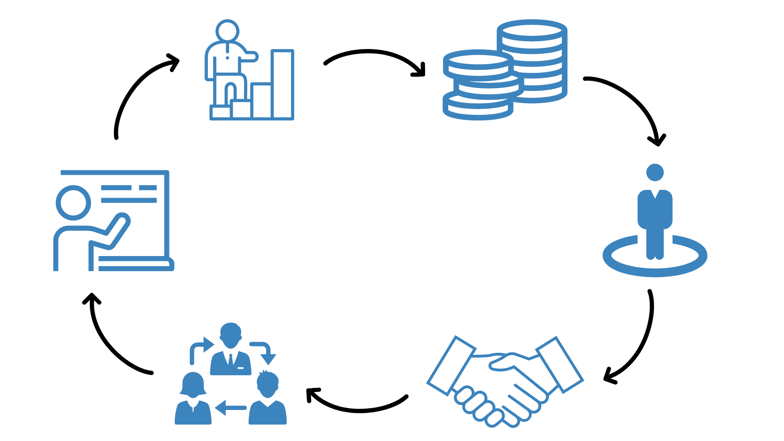
How can I tell if it’s a good apprenticeship?
Notes:
We are often asked by parents if there is any way to find the ‘best apprenticeships’.
The answer is that it will be very personal to each young person and the employer.
But we do have a few hints and tips.
1. What are they being paid? We’re not saying that the highest paying employers are the best or the lowest paying are the worst. A fair wage is an encouraging indicator that the employer is willing to invest in their staff. Remember, employers are able to pay apprentices the National Minimum Wage for Apprentices which is different to the standard National Minimum Wage. This should all be considered alongside the industry standard and what their different pay scales are.
2. What are the likely progression opportunities? If the employer openly discusses progression then it a good sign, they want to keep the apprentice on. Also do you research and check out the employer's website, they may have success stories on there.
3. Is it a permanent or fixed term position? Employers can offer apprentices either a permanent or fixed term apprenticeship. If they are offering fixed term apprenticeships, research if the employer support moving staff into permanent roles on completion.
4. Which training provider are they using? Just like schools – you can check the Ofsted rating of the training provider they are using. You could also look at their website and see if there are any apprenticeship success stories.
5. Is the role varied? Read the job description and see if the employer offers the opportunity to rotate around the business and be involved in a variety of projects.
6. Employer ethos and values You can understand a lot about an employer through their website, social media channels, how they share certain communications and what their values and ethos are. Are they the type of employer your child wants to work for? What else do they do around the apprenticeship for their current apprentices e.g. support networks? How do they support diversity and inclusion? This can help you and your child to get a feel for the employer and their commitment and support of apprentices.

Slide 14
Hear from apprentices
Notes:
Presenter notes: If you have an apprentice ambassador with you, please replace this slide with their presentation.
Delivery partner to insert film of their choice about apprenticeships.
Depending on the audience, films that we would recommend considering showing here are all available on amazingapprenticeships.com
We would recommend that you download the film onto a memory stick and take it with you.
Some establishments will not have sufficient internet access.
Understanding apprenticeships _ Full version (4m 41s) https://vimeo.com/151121127 Technology apprenticeships for the new generation (4m 22s) https://vimeo.com/158818858
Higher and degree apprenticeships – make them your plan A (2m 58s) https://vimeo.com/173753735
Apprentices are amazing film – link tbc
World Skills Champions films – link tbc

Slide 15
Resources for parents
Apprenticeships.gov.uk
Notes:
We also wanted to let you know that there are other resources completely free of charge that can help you as parents.
Monthly parents magazines that are produced by Amazing Apprenticeships are available on apprenticeships.gov.uk. They are really useful and contain lots of different articles and guidance for you, including on apprenticeships as well as other technical pathways like traineeships and T Levels.
Your school may circulate this to you, but you can also subscribe to receive it by visiting Amazingapprenticeships.com (the URL for which will appear on the next slide).
We also have a parents factsheet translated into 5 different languages including: Arabic, Latvian, Pashto, Romanian and Urdu,
These can also be downloaded from apprenticeships.gov.uk.

Slide 16
More information
Notes:
For other useful information and more resources, you can also go to www.amazingapprenticeships.com.
There are some brilliant resources available.
The web address is showing on the screen now so please make a note of it

Slide 17
Any questions?
Notes:
But for now, are there any questions at all?
Thank you so much again for joining this session today.
Close session

