Slide 1
Year 12 Parents Meeting 2021
Online Version
Mayfield Grammar School

Slide 2
Aims of this document:
Explain the Sixth Form at MGSG
Clarify our expectations of the students and your role in helping them to meet these expectations
Introduce the Careers and Higher Education Programme
The Year 12 Tutor Team at Mayfield Grammar School-
Form Tutors:
12BCD Miss B Child (childb@mgsg.kent.sch.uk)
12BAL Mrs B Atwal (atwalb@mgsg.kent.sch.uk)
12SBY Mrs S Berry (berrys@mgsg.kent.sch.uk)
12HSN Mrs H Soan (soanh@mgsg.kent.sch.uk)
12MWH Mr M Weilbach (weilbachm@mgsg.kent.sch.uk)
12WVE Mr W Valentine (valentinew@mgsg.kent.sch.uk)
Sixth Form Teaching & Learning Coordinator:
Ms B DeBeer (debeerb@mgsg.kent.sch.uk)
Careers Advisor
Miss A Johnson (johnsona@mgsg.kent.sch.uk)
Learning Leader
Mr B Slight (slightb@mgsg.kent.sch.uk)
Head of Sixth Form
Mrs L Absolon (absolonl@mgsg.kent.sch.uk)
What is Sixth Form?
Preparation for life beyond school
Becoming more independent in both learning and decision making
Taking responsibility for your own achievement, involvement in school life, developing leadership skills, engaging with the school and wider communities
Formal examinations
Preparation for Higher Education
Preparation for employment
Key dates
8th October- First Year 12 progress review available.
24th November 4:00-7:00pm Year 12 & 13 Parents Evening
17th - 22nd January- Year 12 in-class assessment week
18th May- 27th May- Year 12 internal tests
14th June- 4:00-6:30pm Year 12 Parents Evening
17th June- Year 12 internal exam results published
August (Date TBC)- AS Level results day

Slide 3
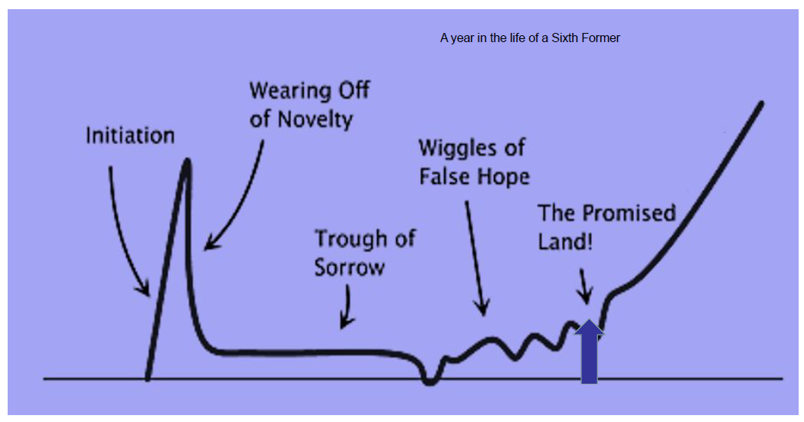
What are A Levels today?
A Levels are now linear– 2 year courses with examinations at the end of the 2 years. AS Levels can still be taken with some courses.
At Mayfield Grammar School, students start with 3 or 4 subjects, continuing with 3 into Year 13. Students will confirm which subject will be their AS Level after their mock examinations.
Continuation from the Year 12 course to the Year 13 course in a subject is dependent upon passing the internal examination at the end of Year 12. If a student gains only a D or E grade she/he will be expected to re-sit part of that examination to improve the marks in order to continue with the course in that subject. No student can continue a subject without a pass grade at the end of Year 12
When applying to UCAS, students may have an AS Level and EPQ qualification. The EPQ qualification will begin towards the end of Year 12 with final assessment taking place in Year 13.
Enrichment at Mayfield
We pride ourselves on our enrichment at Mayfield Grammar School and this continues for students throughout the Sixth Form. The primary purpose of this is to prepare students to be lifelong independent learners, cope with the practicalities of the real world and to broaden their horizons.
Enrichment is delivered through General Lecture, Prep and PSHE lessons alongside opportunities for students to get involved in activities such as volunteering in the wider community.
All students are encouraged to complete work experience because it is important in developing employability skills and in helping students to consolidate their future career paths. Employers and universities increasingly expect applicants to have some relevant work experience.
A year in the life of a Sixth Former
As with all new pathways, studying towards A Levels can be both incredibly challenging and very rewarding. It is natural for students to go through periods of both positive and negative feelings towards their studies and it is important to remember that the next two years are a marathon and not a sprint. Building up an effective and resilient approach to adversity is just as important as achieving their full academic potential.

Slide 4
Our expectations
We do expect the following from our Sixth Form students:
Commitment to their studies
Involvement in school community
Adherence to school procedures
High levels of punctuality and attendance (Above 97%)
High standard of dress and appearance
Over the next fortnight, students will be expected to sign a Student Learning Agreement which is a contract between them and us as a school. The contract outlines information regarding the following:
Authorised and unauthorised absence
Notification and evidence
Other expectations
Bursary Fund
Our commitment to support
In exchange, students can expect a high quality education, careful monitoring of progress against potential, ongoing communication, a high level of commitment to pastoral welfare and a good programme of preparation for the future from Mayfield Grammar School.
We reserve the right to remove students from courses at any point if their performance fails to reach certain standards.
In general the criteria we would operate may be summarised as expectations that the student will achieve standards of progress and behaviour that are 'reasonable’.
Some specific examples are:-
Where attendance at school, or in individual subject lessons, falls below 98% without satisfactory explanation.
Where at least 90% of the pieces of work set are not completed satisfactorily.
Where the student's progress continues to fall below acceptable standards as measured by progress reviews and report assessments.
Where behaviour is hindering the progress of either the student or the group(s) she/he is part of.
What should you expect from your son/daughter?
4 hours study outside lessons per subject per week
Attendance at school by 8.30am, every day.
Full attendance at school throughout the day
Regular ‘homework’ in all subjects
Continuation of courses through to the summer exams in Year 13
Stress(!) Especially at exam and coursework deadlines.
In order to help your daughter/son achieve their full potential, we would ask that you support them by discouraging too much paid employment outside school. We recommend no more than eight hours paid employment per week to ensure a correct balance between home, studying and employment.

Slide 5
Managing time effectively
Attendance in the Sixth Form is vital. Attendance at all taught lessons (including PREP and the General Lecture) and tutor periods is compulsory. Year 12 student are permitted to leave school at lunchtime but must sign in and out at the Attendance Hatch. They must remain on site at all times, even if they do not have a taught lesson for Period 5.
Success at GCSE does not necessarily equate to automatic success at A Level and there is a direct correlation between poor attendance and low attainment. Students are expected to be in school for all of their lessons and our expectation is that students maintain above 97% attendance to school.
Outside of lesson time, students are encouraged to spend an average of 15 hours per week focusing on their chosen subjects. Students are encouraged to manage their time effectively and prioritise their workload to maximize their chance of success.
Monitoring progress
The Go4Schools ICT system which was previously used by us to record and monitor progress has now been replaced by Edulink. Throughout the year progress data will be available via Edulink which is an online portal that allows you to access your daughter’s/son’s progress grades across their time in Sixth Form.
Please see the email which was sent to you on Thursday 2nd September for further detail and how to access the new system. If you have not received your login details, please contact the school.
What else can you do to help?
Read the student booklet
Try to monitor time spent on school work
Help to meet attendance and punctuality targets
Encourage participation
Contact school if you are concerned.

Slide 6
Teaching and learning
In Y12 students will continue to make use of the Mayfield Learning Framework.
The Mayfield Learning Framework identifies five key facets of learning which we believe underpin all successful learning and we would like each of our students to be aware of these skills as they go about each of their lessons.
Cognitive (understanding): what happens in our brain. Are our students able to think critically and flexibly? Are they seeing the connections between the learning and their lessons? Are they working accurately?
Emotional (Focus): How a student behaves in the classroom, interacts with her or his peers, teaching staff and her or his family at home. How do our students demonstrate that they are engaged in their lessons? Do they persevere? How do they manage their emotions?
Strategic (Managing your learning): Relates to the way in which our students plan, review and reflect upon their work. To plan their time well.
Social (Who you learn with): It is important that our students should be able to work with others but also have enough personal resilience to work alone. We want to see our students give, receive and act upon feedback; to see evidence that feedback and targets have been understood and responded to.
Communication (Writing and speaking): We aim to make our students aware of how others receive communication. We would like our students to be active listeners, to communicate clearly, adopting an appropriate tone, taking careful note of spelling, punctuation and grammar.
Preferred learning Styles: There is much discussion in education about the importance of identifying our preferred ways of learning. At Mayfield Grammar School we have always stressed that whilst students have a preferred way of learning, the most effective learners are those who use all three styles of learning.
Visual: mind mapping, highlighting, use of colour and symbols, collages, diagrams, videos, looking at models, watching someone perform a skill.
Auditory: Taping, working with background music, reading aloud, listening to others, using rhymes or mnemonics as an aid to memory.
Kinaesthetic: role play, mime, making models, practical experiences, movement breaks when working or revising, trips and visits, group work.
What advice do our students give to their peers?
View targets as aspirational, rise to the challenge
Work hard in Year 12 to ensure success in Year 13.
View tests positively to help you revise as you go.
Make use of academic tutoring and be prepared for the meeting.
At the beginning of Year 13 start revising, make sure you fill any gaps in knowledge from year 12.
Engage with your lessons, ask questions and seek knowledge.
Establish a regular working pattern.
Take breaks and use your weekends well.
Use your supportive friendship and study groups.
Celebrate success with your family.
Allow your parents to give you structure and encouragement. “We like our parents to trust us to manage our work.”
Read beyond the material that you are given in lessons.
Do the preparatory work before the lessons.
Be kind to yourself and give yourself time to master new skills.

Slide 7
In Y12, we will continue to use VESPA to help our students to work more effectively.
A brief reminder of the five key areas:
Vision: How well do you know what you want to achieve? What are your goals for each subject? What are the grades that you want to achieve in each subject? What do you want to do after your A levels? Do you want to go to university? Are you interested in pursuing and apprenticeship?
Effort: At A level, you need to work outside of the classroom, too. What do you do after every lesson? Do you go home and add more detail to your notes? Do you ensure that you understand all the content covered in the lesson? Do you supplement your knowledge by reading relevant articles, newspaper articles, specialist articles and by watching relevant video clips?
Systems: How do you organise your learning? Are you able to prioritise tasks? Do you use an energy line to put things in order according to how much effort you need to give them? Do you know when is the best time of the day, for you, to attempt challenging tasks?
Practice: What kind of work do you do to practise your skills? Do you attempt similar problems that you looked at in the lessons, at home? Do you respond to feedback? Do you know what your areas of weakness are? Are you able to address these? Do you make use of past paper questions to attempt sections and, then later, full papers?
Attitude: Do you review feedback and seek out examples of better work? Do you try different methods to solve a problem, if the first couple do not work? How do you respond to setbacks? When you go through tough times, are you able to focus on the benefits, successes and to use these to come out on the other side?
What is going to happen during this year?
There will be termly VESPA assemblies which will focus on one of the five themes.
There will be opportunities for speakers to inform students about how they have used the VESPA principles to attain success.
There will be a focus in registration on how they can practically apply the VESPA principles to their subjects.
The General Lecture
All Year 12 students are expected to attend the General Lecture which is arranged throughout the academic year. Topics chosen for consideration include issues such as health, careers, general knowledge and the environment. Special emphasis is placed on social, moral and religious issues as well as on presentation skills and study skills. Outside speakers are invited to these sessions to increase student awareness of the problems facing society today.
RE Conferences
R.E. Conferences and visits are organised for both Year 12 and Year 13 students. These represent the compulsory R.E. elements of the Sixth Form course. Students will attend these unless there are strong religious reasons for not doing so and then a letter from parents is required to withdraw them, explaining the reason for so doing. Conferences cover a variety of spiritual, social, moral and cultural issues.

Slide 8
Careers Information
At Mayfield, our careers programme is designed to help students identify their strengths and interests, as well as encourage students to aim high and develop a careers pathway. We also aim to help students make informed choices and give independent advice and guidance in relation to apprenticeship opportunities and university places.
There are numerous opportunities throughout the Sixth Form that students have to develop their knowledge regarding future careers and pathways. These include:
Use of the dedicated careers library for research
MGSG Twitter feed @MGSGCareers (In order to follow us, we must be able to clearly identify you as a student or parent)
Courses and taster courses run by universities
Work placements to support career choices and university entrance
Community service/Voluntary work
Higher Education Convention- March 2022 - TBC
Oxbridge Conference- March/April 2022- TBC
‘Futures’ booklet Term 6
Using Unifrog to research University/Apprenticeship options and record competencies and activities. (All students in Year 12 will be able to access Unifrog within the next few weeks)
Throughout the next two years, students will also be able to engage with the following activities-
Academic monitoring and conversations with tutors
Y12 and 13 careers interviews with Miss Johnson
Careers research packages for university and career opportunities.
Unifrog- excellent research platform for University and Higher/Degree Apprenticeship searches. Support with CV writing and general Careers research.
Morrisby Profile- Psychometric test that identifies potential Career matches based on students aptitudes and interests.
General Lecture programme- variety of speakers covering different Careers, Post 18 opportunities, Voluntary opportunities, Financial Capability and study Support/Techniques.
Graduate labour market information 2020-21
Employers had expected their Graduate vacancies to rise by 3.3%
Due to the pandemic graduate vacancies actually decreased by 12.3%- however the Graduate labour market is due to recover over the next two years.
The most generous Graduate starting salaries in 2021 are those on offer from Investment banks (£50,000), Law Firms (£46,000), Consulting Firms (£45,000) and Oil and Energy (£40,000)
The quality of graduate applications has improved to reflect increased competition for jobs.
The biggest growth in vacancies is in Public Sector Organisations, Accounting and Professional Services firms and Investment banking and Technology companies who intend to recruit more than 1,600 additional Graduates this year.
32% of last years vacancies were filled by Graduates who had completed work experience with the employer.
Source- High Flyers 2021

Slide 9
Apprenticeships
Students are encouraged to research opportunities early- some employers recruit almost a year ahead.
Follow MGSG Twitter feed.
Many employers now recruit through Linkedin and other social media platforms
Talk to us about what is on your mind.
Prepare thoroughly for the process.
Use the MGSG Apprenticeship and Employment booklet in Year13.
Register with the Government Apprenticeship service: www.apprenticeships.gov.uk
Support with choices
Students will receive our support with choosing the correct path, whatever their aspirations. The university application process will begin in late Spring, early Summer 2022. There will be the option to attend a Higher Education Convention at Detling Showground in March 2022 and there will be a Higher Education Evening in April 2022. Students will also be given a Futures booklet to explain the process further. Before beginning the UCAS application process, students will be given a full explanation into how this will work as well as key deadlines. Students are also encouraged to attend university open days from the end of Year 12.
UCAS applications will be completed during September/October of Year 13. The deadline for medicine/veterinary science, dentistry and Oxford and Cambridge is slightly earlier- 15th October 2022.
Year 13- Further support
As part of the careers programme, Year 13 students will be given assistance with practice interviews and CV writing, support with UCAS and/or apprenticeship applications which will include support and advice on compiling a personal statement. Students are also encouraged to undertake relevant work placements where possible.
“Nearly half the recruiters who took part in the research repeated their warnings from previous years – that graduates who have had no previous work experience at all are unlikely to be successful during the selection process and have little or no chance of receiving a job offer for their organisations’ graduate programmes.”
Source- High Flyers 2020
University or employment? Debt or investment?
Debt Payback-
3 years @ £9, 250 student fees loan
3 years @ £9,203 maintenance loan (more if studying in London)
Debt of around £55,359
Pay back begins the April after graduation RPI plus up to 3% on earnings over £27,295
Income each year before tax | Monthly salary before tax | Monthly repayment
Up to £27, 295 | £2,274 | £0
£28,000 | £2,333 | £5
£29,500 | £2,458 | £16
£31,000 | £2,583 | £27
£33,000 | £2, 750 | £42
Based on SFE Student Loan Calculator.

